Slide 1
Orthogonality and Equivalence
Notes:
The cell can be thought of as a big state machine. When you take the chemical specifics out of the description of the system, you are left with a mathematical object, and many principles from other areas of engineering can be applied to those models. Two terms that pertain to models of this type are orthogonality and equivalence.

Slide 2
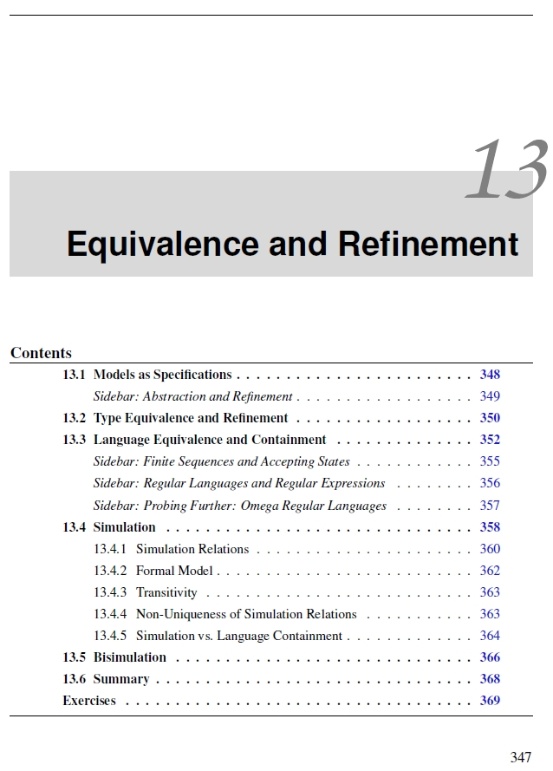
Orthogonality and Equivalence
http://leeseshia.org/
Notes:
In synthetic biology, the term orthogonality is used fairly losely. In areas of computer science and electrical engineering, these terms have a more technical meaning. This chapter of a book by Sanjit Seshia, available online, describes this term ‘equivalence’ in the context of embedded systems, which are the control systems in things like traffic lights. If you want to go deeper into the relationships between genetic engineering and electrical engineering, it’s an interesting read accessible with little prerequisite knowledge. It deals with the the ability to say with confidence that one model of a state machine can be used in place of another. In this way, it deals with the same situation in which we would consider swapping out one set of interacting genes with another.

Slide 3
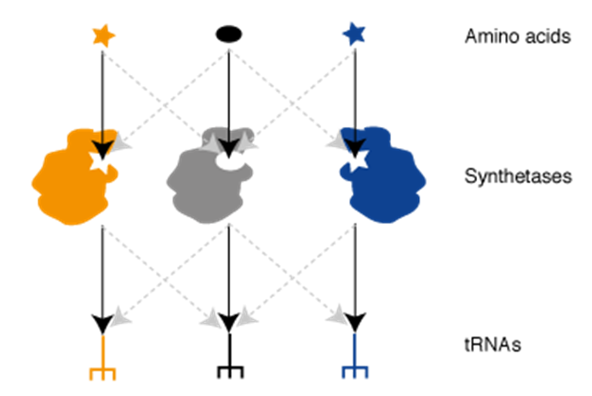
Orthogonality and Equivalence
http://www2.mrc-lmb.cam.ac.uk/ccsb/?page_id=43
Notes:
Orthogonality is a term often used in the context of synthetic biology in many distinct biochemical contexts. To explain what is meant by it, let’s look at an example. During translation, aminoacyl-tRNA synthetases react an amino acid with ATP and then join it to the 3’ end of a tRNA. The tRNAs and synthetases are referred to as being ‘orthogonal’ to one another. What is meant by this statement is that the synthetases only react with their preferred amino acids and tRNAs. From a chemical perspective, this means that the substrate range of the synthetases combined with the specific set of tRNA sequences in the cell leads to a situation in which no cross-reactions occur. In this system, where orthogonality most comes into play is when we try to add another synthetase to the cell, or replace one of the endogenous ones with a different version. For example, suppose we try to knock out the phenylalanine synthatase in E. coli and replace it with the copy from B. subtilis. Because the sequences of tRNAs and synthetases in the other organism are slightly different, one cannot be sure that these molecules will still be orthogonal in their new context. Sure, these genes are all highly-similar to one another, but it turns out that their specificity drifts slightly over time. It is not uncommon in these experiments for the replacement synthetase to kill the cell by charging the wrong tRNA or not recognizing the native tRNAs. In the context of this specific system, orthogonality and equivalence represent two extremes of how a biomolecule will interact with others in the engineered cell. An equivalent synthetase would have the same set of interactions with the native species, and an orthogonal synthetase would have no interactions with the native species.

Slide 4
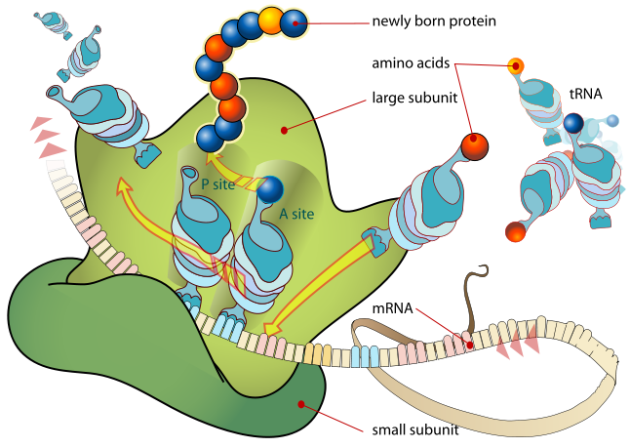
Orthogonality and Equivalence
Notes:
Equivalence is a clean concept. One biomolecule could have exactly the same set of interactions as another. Orthogonality is a little thornier. Nothing in the cell is orthogonal to anything else.
All the proteins are made of amino acids, and all RNAs are made of ribonucleotides. These precursors are tied into primary metabolism and regulation. Also, one would still expect anything that looked like a tRNA to interact with the ribosome, EF-Tu, and so forth. So, it is clearly not the case that this term orthogonal refers to the absolute case that there are no interactions. It’s more subtle.
More typically, what people mean by ‘orthogonal’ is that amongst a specific subset of analogous interactions in the cell, the introduced biomolecule will not interact or interfere with that endogenous subset. In the case of the orthogonal synthetase, they mean that it doesn’t do aminoacylation to anything but its own tRNAs. There is no guarantee in the claim that the synthetase won’t participate in protein protein interactions with an unrelated transcription factor and thereby interfere with gene regulation; the claim is restricted to a subset of related interactions.

Slide 5
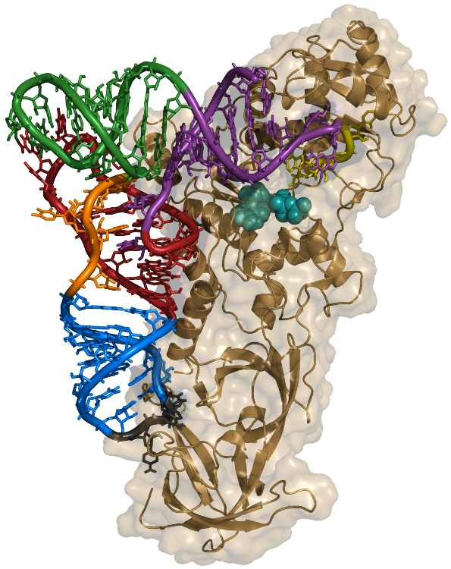
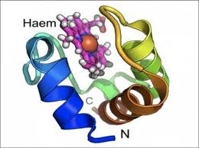
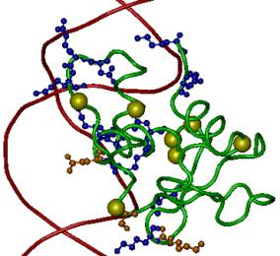
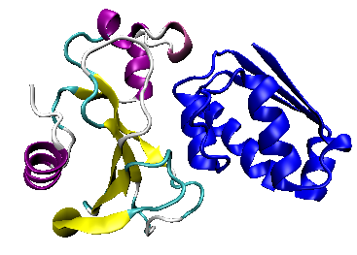
Orthogonality and Equivalence
B
A
B
A
A₁
B₁
B
A
A₂
B₂
A
A
B
A₃
B₃
B
Notes:
Consider we have two biomolecules A and B that have some non-covalent interaction with one another. *click* A and B could be a synthetase and a tRNA as we have already described and shown top right. It could be the interaction between a small molecule such as a cofactor as illustrated by a Haem-binding protein top left, or it could be the interaction between a DNA sequence and a protein, or the interaction of two proteins. Orthogonality deals with the cross reactions between a subset of highly-similar molecules. For example, we might be speaking of the interaction with the Haem-binding protein and other porphyrins, or the binding of an antibody to different peptides. Let’s consider the example of the tRNA and synthase again. *click* Suppose I have three tRNAs, A1, A2, and A3, and three synthetases B1, B2, and B3.

Slide 6
Orthogonality and Equivalence
A
B
A₁
B₁
A₂
B₂
A₃
B₃
Notes:
We would say that this set of ‘A’s is orthogonal to one another by virtue of the fact that they do not cross react with their cognate ‘B’s. Orthogonal parts like this are desirable for scenarios in which you don’t want your introduced genes to cross react with related processes in the cell.

Slide 7
Orthogonality and Equivalence
A₁
B₁
B₂
C₂
if
B₁
=
B₂
A₁
B
C₂
Notes:
Equivalent parts are also useful. Consider that we have three types of species: A, B, and C. If a specific sequence of A, A1 interacts with a specific B1, and B2 interacts with C2, then we would not immediately assume that putting all three in the same cell would cause anything new to happen. However, if B1 and B2 are functionally equivalent in some way, then there is a new network of interactions that results by putting them in combination.

Slide 8
Orthogonality and Equivalence
A
A
Notes:
If we consider the case of metabolic engineering, then we can discuss the orthogonality and equivalence of chemical intermediates in the cell. Suppose that A is an intermediate such as chorismic acid. The species of cytoplasmic chorismic acid is defined by the equivalence of their covalent structure and the microstates that molecule can exist in. The conformational states accessible to any one molecule of chorismic acid are the same as any other, and any position within the cytoplasm is equally accessible by any other. The molecules are thus all equivalent within the cell, and that is how we define them as a distinct species.

Slide 9
Orthogonality and Equivalence
A
A
Notes:
One way of disrupting this equivalence is through compartmentalization. For example, we could put A inside an organelle and thereby restrict the location accessibility of the molecule. Now, we have a new species that is organellar-A that is not equivalent to cytoplasmic-A.

Slide 10
Orthogonality and Equivalence
A
A
Notes:
We could also have a complex of A. Though A presumably can still dissociate and access the same states as free-A, that bound state would participate in its own set of interactions and is thus a distinct species. In the context of metabolic engineering, we have made a major distinction between the monofunctional enzymes and polymeric megasynthases because of the major difference in design caused by the complexation of the substrate to the enzyme in the latter case. When the enzyme just lets go of the product, all molecules with that structure become equivalent and thus the effect of putting enzymes together in combination is predictable. In the megasynthase case, one cannot make any assumptions about equivalence of the chemical intermediates themselves because they are no longer equivalent due to their participation in a complex.

Slide 11
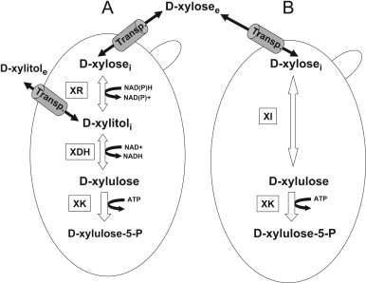
Equivalent Pathways
Notes:
The concept of equivalent or orthogonal biomolecules can also be applied to sets of biomolecules. Here we see two different routs for catabolism of xylose. In pathway A, xylose is transported, then reduced, reoxidized, then phosphorylated to get the product. In pathway B, xylose is transported, then phosphorylated directly. Both routes have the general effect of inputting extracellular xylose and outputting cytoplasmidc xylulose-5-phosphate. From a design perspective, these sets of enzymes are equivalent in the sense that you could use either one to achieve the desired affect of incorporating xylose into metabolism.

Slide 12
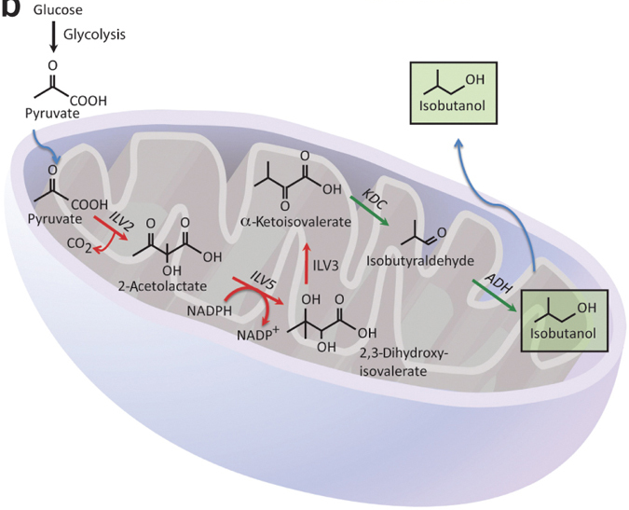
Orthogonal Pathways
http://www.nature.com/nbt/journal/v31/n4/fig_tab/nbt.2509_F1.html
Notes:
Similarly we can speak of orthogonal pathways. For example, we can orthogonalize a biosynthetic pathway by localizing the entire path to an organelle. Here folks moved the Atsumi pathway from the cytoplasm to a mitochondrian. In this way, all the intermediates and enzymes are now distinct species from their cytoplasmic counterparts. These strategies have the desired affect of preventing unwanted interactions in the cell that can cause toxicity or loss of flux.

Slide 13
What are some other ways to orthogonalize a biosynthetic pathway?

Slide 14
Transferring a PKS to E. coli
Notes:
Polyketides natively have an unfortunate tendency to exist in organisms that are difficult to bioengineer. Many of them are fungi or bacteria that simply aren’t genetically tractable. The difficulty of installing a DNA into a cell is what primarily determines how many genetic constructs you can test in an experiment. Because of this fundamental bottleneck, it is far easier to engineer a pathway once you have moved it into a genetically-easy organism like E. coli or Yeast.

Slide 15
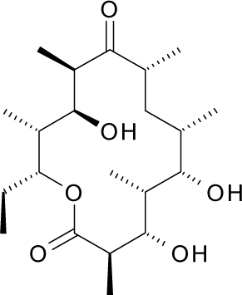
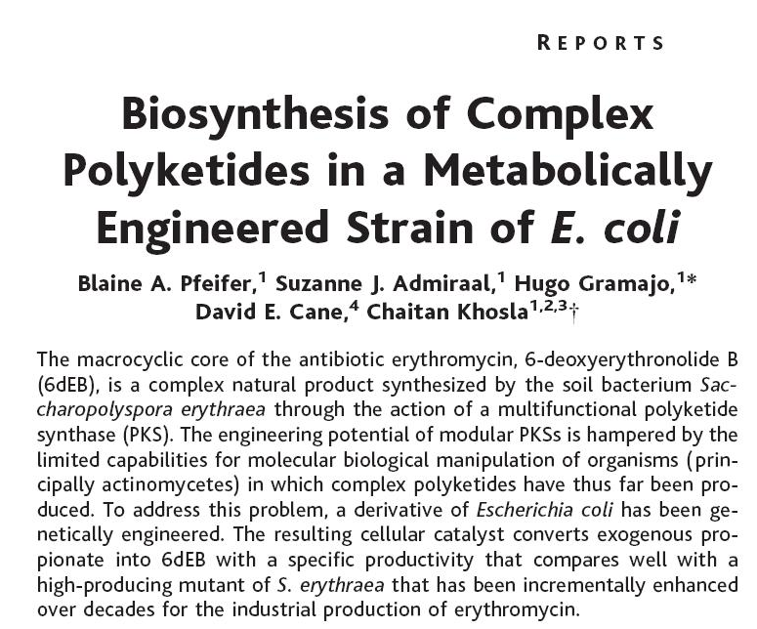
PMID 11230695
6-deoxyerythronolide B
Notes:
In this study, Khosla and coworkers move the biosynthetic pathway for the macrocyclic core of the polyketide antibiotic erythromycin into E. coli.

Slide 16
The problems
The polypeptides are unusually large for E. coli
Megasynthases are posttranslationally pantetheinylated (the ACP’s thiol)
The initiating carboxylic acid, propionyl-CoA, isn’t a plentiful metabolite in E. coli; E. coli makes no methylmalonyl-CoA extender unit
Likely need to deal with flux from the precursor metabolites through to polymerization
Notes:
There are several problems that were encountered in this study and have since been encountered generally when trying to move PKS and NRPS pathways into E. coli.
First, the polypeptides are unusually large for E. coli. The largest E. coli proteins are around 1200 amino acids, and megasynthases are often 2000 amino acids. Though many of the organisms that natively produce these enzymes are prokaryotes, the translational and chaperone machinery is different enough between these organisms that these genes often do not express well in enterobacteria. It is common to observe low protein abundance or non-functional misfolded proteins.
Second, the megasynthases need to be pantetheinylated to supply the thiol linker on each ACP domain. Though this all boils down to adding another enzyme to add that group, sometimes an appropriate enzyme is unknown.
Sometimes one of the monomer units is not produced in the chassis. In this biosynthesis, propionyl-CoA is the initiating unit. This metabolite is made in E. coli, but in low abundance and flux. The methylmalonyl-CoA extender unit isn’t made in E. coli at all, so pathways would need to be added to provide these.
Finally, E. coli doesn’t naturally produce anything from propionyl-coa or methylmalonyl-coa, so it’s unlikely that the cell’s primary metabolism is optimal for their production. Flux through these precursors would likely need to be optimized by the usual means of promoter switches and genome knockouts.

Slide 17
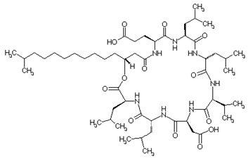
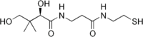
Protein Expression and Pantetheinylation
Pantetheine is already made by E. coli as coenzyme A, but the DEBS for deoxyerythronolide are not pantetheinylated when expressed recombinantly
They add sfp from B. subtilis, a pantetheinyl transferase associated with a surfactin (above right) biosynthetic pathway
These transferases have specificity PMID: 8939709
Expression of the 3 DEBS genes gave protein, but only DEBS1 was functional after purification in vitro
Getting DEBS2 and DEBS3 to work required lowering the expression temperature from 30° to 22°C
pantetheine
Notes:
To get the protein expressed and properly pantetheinylated, they note that pantetheine is already present in E. coli. It is a component of coenzyme A. However, when they express the DEBS gene for deoxyerthronolide, the enzyme doesn’t get modified.
*
To resolve this, they add the sfp gene from B. subtilis. In that host, this enzyme transfers pantatheinyl groups to the megasynthase for production of surfactin. Though surfactin and deoxyerythronolide have no particular structural similarity to one another, they are similar enough from the perspective of the pantetheinyl transferase. However, not all of these transferases have the same specificity, and they don’t all work on all PKS modules.
*
There were also difficulties expressing the polypeptides. All 3 DEBS genes produced protein, but only DEBS1 was functional after purification in vitro. They found that by lowering the growth temperature to 22degreesCelcius, they could get the other two to express. This trick of reducing the temperature is often done in producing protein for crystallography. It helps proteins fold rather than aggregate by slowing everything down.

Slide 18
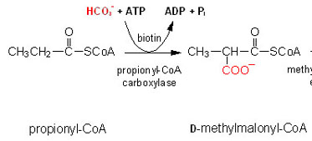
Production of input metabolites
Knockout the prp operon encoding proprionate catabolic genes
Overexpress E. coli prpE which ligates proprionate onto CoA
Add the Propionyl CoA carboxylase genes (pccA and pccB) from S. coelicolor to make methylmalonyl-CoA
Overexpress E. coli birA biotin ligase to improve biotinylation of pccA
Notes:
They need to produce large amounts of proprionyl-CoA and methylmalonyl-CoA, so they knockout the prp operon encoding proprionate catabolic genes to avoid degradation. They also overexpress E. coli prpE which ligates proprionate onto CoA to increase flux to proprionyl-CoA
*
This intermediate, proprionyl-coa is also the penultimate step to methylmalonyl-coa. They add the Propionyl CoA carboxylase genes (pccA and pccB) from S. coelicolor to catalyze this reaction. Note that this enzyme is fixing carbonate, which is just carbon dioxide dissolved in water, by incorporating it into the substrate as a carboxyl group. This type of chemistry requires the cofactor biotin and ATP. The biotin is a chemical modification to the pccA subunit of the carboxylase. It turns out they need to overexpress the E. coli birA gene encoding biotin ligase to get pccA well-biotinylated.
Thus, the total modifications needed to observe product formation was a substantial effort. I find this paper particularly interesting because the things they must do to get this system working have are all very reasonable, logical, and explainable. However, they also get a little weird. It is easy to think about a complicated genetic device in terms of black box diagrams and forget the biochemical details of what goes on inside. This paper clearly illustrates how a deeper understanding of the biochemistry of the system can be essential to getting a device up and running in the cell.

Slide 19
Mixing and Matching PKS Modules
PMID 19217343
or PMID 15539364
Notes:
The apparently modular architecture of PKS and NRPS megasynthases immediately makes one wonder what happens when you mix and match the modules or domains.

Slide 20

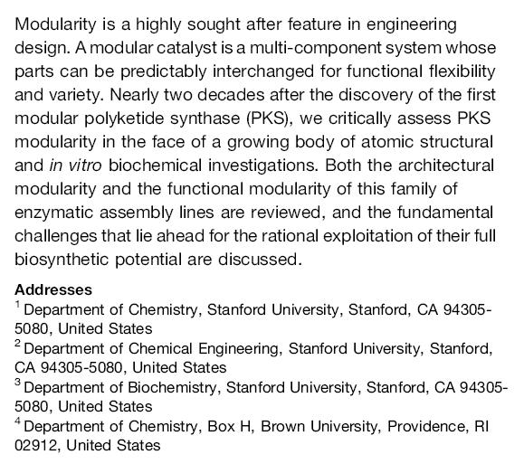
Notes:
In this review, Khosla and coworkers describe what happens when you try to make chimeras out of PKS systems.

Slide 21
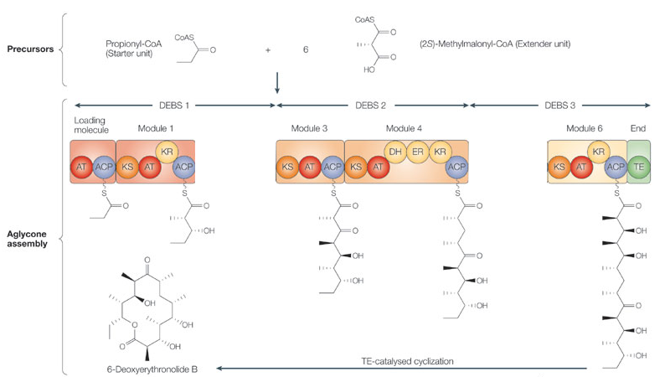
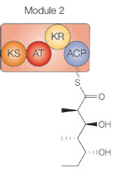
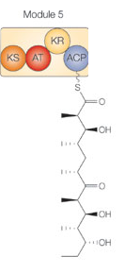
Modularity of polyketides???
Notes:
It is very clear from examination of the sequences of these biosynthetic pathways that this organization of modules and domains is in some way modular. Bioinformatically, it is very common to observe that structurally related PK/NRP enzymes are chimeras of two or more ancestral pathways. It is also self-evident that the junctions for the chimeras are consistently at domain and module boundaries. So, what would happen if I *click* swapped the positions of two modules in the megasynthase? For example, what would the product be if I *click* flipped the positions of module 2 and module 5?

Slide 22
Modularity in polyketide biosynthesis
“A modular system may be defined as a multi-component system that can be divided into smaller subsystems, which interact with each other and can be predictably interchanged for functional flexibility and variety.”
Modularity can occur at multiple scales
But which scales actually are modular?
Clear modularity interfaces around the soluble precursors
The review is asking the question of whether you can view the PKS polypeptides in their entirety or the domains as interchangeable modules
Notes:
A modular system may be defined as a multi-component system that can be divided into smaller subsystems, which interact with each other and can be predictably interchanged for functional flexibility and variety. *click* Let’s consider an example PKS gene cluster.
There are many scales at which you might find modularity: the entire native biosynthetic cluster, the refactored set of proteins associated with the gene cluster, the individual coding sequences, and finally the individual domains
*
The question is which of these scales are truly modular—where are there well-defined interfaces that can be recognized as being orthogonal or equivalent
*
These biosyntheses are clearly modular around the production of precursors and cofactors. For example, if your PKS needs proprionyl-coa you do not need to use the native genes; any path to that soluble intermediate will satisfy the design.
*
This review is asking about the domains and modules. Are those interchangeable too?

Slide 23
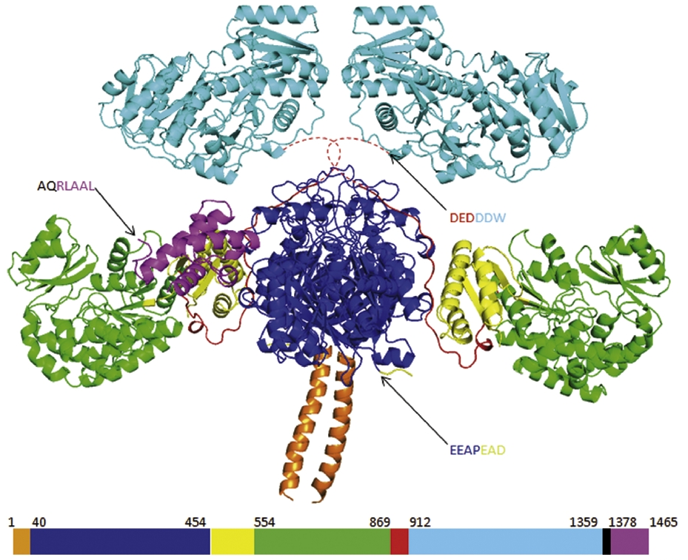
Modularity of PKS modules
Most chimeras are non functional
Expression and folding of the modules is modular
Expression and folding of the domains is also modular
ketoreductase (KR) domain
acyltransferase (AT) domain
acyl carrier protein
(ACP) domain
ketosynthase (KS) domain
Notes:
Most attempts to make chimeric PKS designs have resulted in low or no yield of the chimeric product though there are successful examples
*
It is usually not a folding problem. The modules themselves tend to retain structural and functional integrity as stand alone proteins. You can express just a module in the cell, fused to other things or not, and its expression tends to be contained within the module’s sequence and thereby insulated from higher-order engineering.
*
Similarly, the ketosynthase (KS), acyltransferase (AT), acyl carrier protein (ACP), KR and DH domains of PKS modules all retrain structural and catalytic integrity as stand-alone proteins. Thus, based on simple logic that we would use for monofunctional enzymes, PKS systems would appear to be functional at both the domain and module levels. They express, and they maintain their ability to perform chemistry. Where things go awry is in the communications between the modules and domains.
*
Here I show the crystal structure for one of these modules. *click* You can see how the ketoreductase and acyl-carrier protein are spatially positioned around the ketosynthase domain. When you look at these systems at the primary sequence level, it is easy to forget that this is an intricate 3-dimensional molecule.

Slide 24
Modularity of PKS modules
Most chimeras are non functional
Expression and folding of the modules is modular
Expression and folding of the domains is also modular
The issues appear to be with the linkers or a lack of true naivety towards their substrate
The natural systems may have become canonized
Notes:
The difficulties in mixing and matching these things is usually attributed to mismatches in the linker regions between the domains and between the modules. However, it could also be attributed to a lack of true naivety towards the substrate. For example, a module in principle could examine the stereochemistry of a unit added two steps prior and reject the substrate. If such specificity exists, it would be very difficult to recombine the modules.
*
It is also possible that the system became canonized. This word ‘canonization’ refers to the situation in which a gene has been isolated within a genome for so long that its sequence has drifted, and it no longer operates under the same principles as its siblings. For example, the linker regions might have evolved a new fold that isn’t compatible with the linker regions of the siblings.

Slide 25
The linker issue
The linkers make up a substantial portion of the polypeptide length
Extensive interactions exist between the linkers and catalytic domains
Some of the linkers appear to be universal, some don’t
The ones joining module-to-module appear to be universal
Changing the domain-domain junctions usually results in rate impairment
Choosing several linkers sometimes fixes the problem
Another approach is to hold the linkers the same and modify the domains to make them do different chemistry
Can fix poor junctions with directed evolution
Notes:
Khosla attributes much of the difficulty in making chimeras to the linkers. These linkers make up a substantial portion of the polypeptide’s overall length, and there are extensive contacts between the linkers and catalytic domains.
*
Some of the linkers appear to be universal, but not all. The ones that join module-to-module appear to be universal. Thus, it is usually easier to make chimeras at the level of modules than at the level of domains.
*
If you change the domain-domain junctions, usually there is miscommunication between the domains and a rate impairment. Trying several linkers often fixes the problem resulting in functional chimeras.
*
Another approach is to hold the linkers the same but just swap out the catalytic portions of a module. For example, you might swap an R-enantiomer-generating KR domain with an S-generating one but retain the native domain’s linkers.
*
Regardless of the initial chimera, it is usually necessary to do directed evolution to ‘fix’ an otherwise non-functional interface

Slide 26
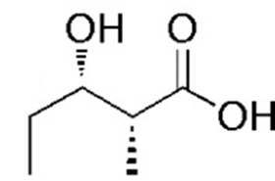
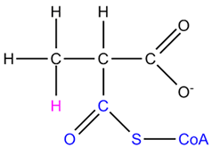
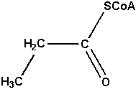
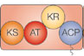
Functional composability
For a chosen molecule, it is trivial to know what types of domains need to be strung together to make the product. Let’s try one:
Notes:
Using some fairly simple reasoning, we can write out the domains and modules required to build a particular polyketide.
Let’s try an example. Suppose I want to make this polyketide. I know PKS builds two carbons at a time, and it’s always two at a time, so the moving back from the acid two carbons would put the new bond *click* here. There aren’t enough carbons here to have two steps of PKS synthesis, so this is just the initiating unit on the left and an extender unit on the right. The extender unit appears to use *click* methylmalonyl-CoA since there is a methyl group dangling off. Let’s focus on the new bond. *click* We see that we have an alcohol, and it is not methylated, and it didn’t get eliminated. This suggests that the module had a KR domain for the reduction of the ketone to the alcohol, but it lacked a DH or MT domain. We can also see that this is the initiating module, and there would be a methyl side chain on the initiating carboxylic acid, so it must have initiated with *click* propionyl-CoA. All modules have the AT, KS, and ACP domains, so our module looks something like *click* this.

Slide 27
Functional composability
For a chosen molecule, it is trivial to know what types of domains need to be strung together to make the product
The difficulty is choosing the exact correct combination of chemically-equivalent domains and linkers to make it all work in concert
This is called functional composability problem
Ideally we’d have models to predict this
Unclear if that would require 3D models
Directed evolution also works
Notes:
The devil is in the details—in this case arbitrary choices for these parts usually results in no function, but some combination of parts will result in the desired function. The difficulty is choosing the exact correct combinations of domains and linkers to make it all work in concert.
This is the essence of a functional composibility problem – how do you determine exact compositions of parts that together do exactly what you want them to do
Ideally, you’d want a set of biophysically-based algorithms, or heuristic rules that allow you to make these predictions.
One challenge is that we are talking about issues of 3D structure, and the algorithms might require high-resolution crystal structures to be meaningful. Such modeling is moving quickly, but this today would challenge our abilities.
The alternative is to do lots of combinatorial libraries or directed evolution. That does work, and we’ll see an example of that, but it is a more expensive experiment.

Slide 28
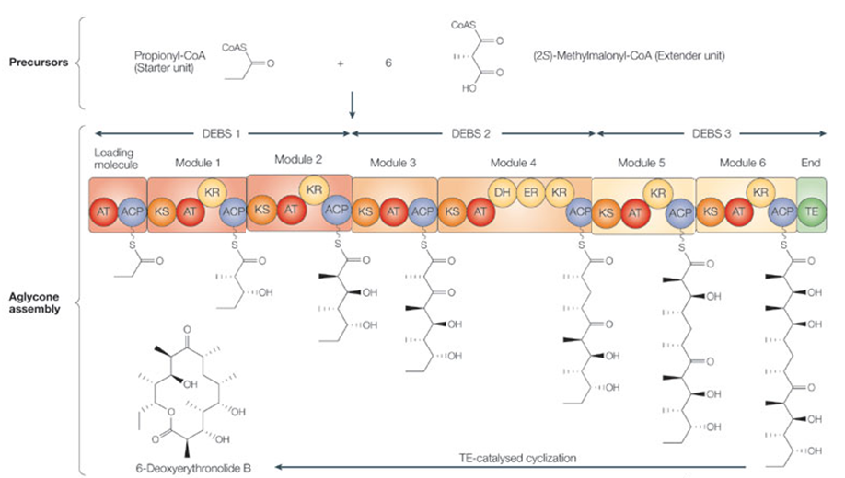
What chemical might result from switching modules 2 and 5?

Slide 29
Optimization of Megasynthases with Libraries
PMID 17620609
Notes:
When one alters the domain or module composition of a megasynthase, it is common to lose product formation. Presumably the polymer gets stuck somewhere on the protein and shuts it down. Functionality can sometimes be restored using directed evolution.

Slide 30
Combinatorial Libraries/Directed Evolution
Combinatorial libraries involve mixing and matching of parts
The libraries often get large, in this case 3^4 = 81
Directed evolution involves doing iterations of mutagenesis and screening on a design to incrementally improve activity
Often used in concert
Notes:
Combinatorial libraries involve the mixing and matching of parts. *click* Consider we have 4 different bins each containing 3 genes. We want to know how many different 4-gene operons we can produce. In this case, there are 3 to the 4th or 81 different combinations.
*click*
Directed evolution techniques involve doing iterations of mutagenesis and screening ona design to incrementally improve activity.
*click*
A typical approach is to start with combinatorial libraries to generate an initial hit, and then apply directed evolution to evolve it further.

Slide 31
How does error-prone pcr work?

Slide 32
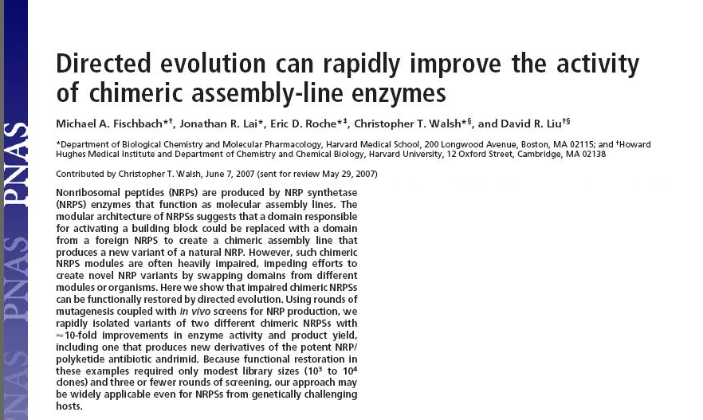
Notes:
In this paper by Liu and coworkers, a chimeric non-ribosomal peptide synthase is improved using a combination of random mutagenesis and genetic selection.

Slide 33
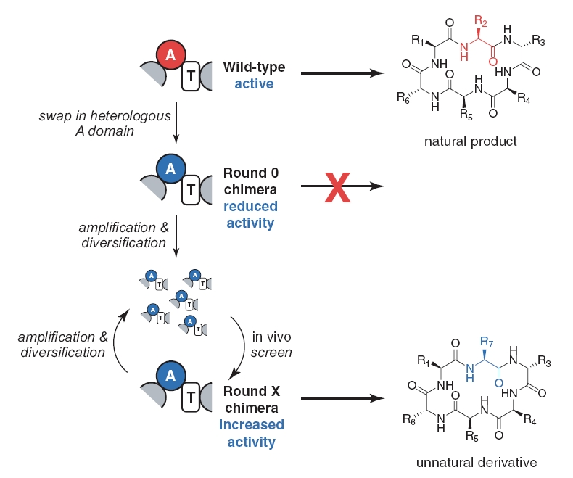
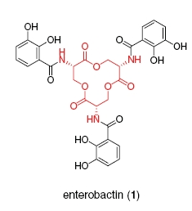
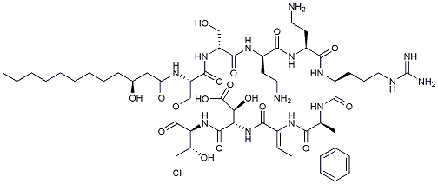
Chimeric enterobactin NRPS
syringomycin
Notes:
This first figure describes the idea behind the experiment, but not the chemicals they are actually working with. The idea is you start with a non-ribosomal peptide synthase, and it has one A domain (in red) that is choosing some amino acid R2 in some natural product. If you replace this domain with an A that likes a different amino acid R7, that tends to result in low product formation. Through rounds of directed evolution you could restore activity producing an unnatural derivative containing the replacement amino acid R7.
*click*
The molecule they first apply this to is enterobactin. This chemical is a secondary metabolite involve in high-affinity iron transport. It is natively produced in lab strains of E. coli and is encoded by a 2-module NRPS. They replace entF which encodes the serine-specific A domain. They complement it with the SyrE-A1 A domain from the Pseudomonas syringae syringomycin which also incorporates serine and thereby produces the same chemical product, but with 30-fold less activity. Through directed evolution they are able to restore activity to within 4-fold of the wild-type protein. In this experiment, they are greatly aided by the fact that high-affinity iron transport is a readily-selectable phenotype. Restoring the production of enterobactin enables cells to be selected based on growth on iron-depleted media.

Slide 34
Directed evolution to improve NRPs
Do random mutagenesis of the introduced A domain, 1.6 mutations per library member
Use a direct selection for enterobactin production to sift through the 2E4 different variants
Identify ones that restore within 4x of wild-type activity
This requires a selection or screen for the function of the molecule
Notes:
To perform this directed evolution experiment, they use random mutagenesis of the introduced A domain gene at a rate of 1.6 point mutations per library member.
*click*
Because enterobactin production is selectable, they challenge the 20 thousand different variants to iron limiting conditions, and examine the cells that survive.
*click*
From the hits, they find variants that restore activity within 4-fold of wild-type
*click*
Directed evolution experiments like this aren’t too difficult when you have an easy selection like this. For non-selectable phenotypes, such screens often get instrumentation and cost-intensive. So, what would you do if your goal was to make monomers for some high-tech new Gecko glue material? With today’s tools, this would be an expensive activity.

Slide 35
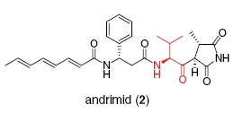
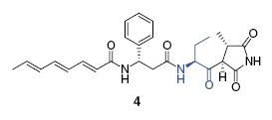
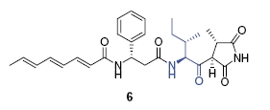
Chimeric andrimid NRPS
Can screen for production using andrimid-sensitive E. coli imp mutant
Targeted the valine-specific A domain of AdmK
Notes:
One useful phenotype that *is* readily screanable is production of antibiotics. You can watch the culture of a test variant suppress the growth of a test strain. Here, they use an E. coli imp mutant. In this same paper, the authors apply the replace-and-evolve approach towards an antibiotic called andrimid. The next-to-last step in this biosynthesis involves a valine-extending module. *click* They put in modules that employ isoleucine and ethylglycine. After introduction of mutations, they screen the variants for killing the test strain. This assay would work as long as the antibiotic still kills the cell, and in this way it also tests the bioactivity of the new potential antibiotic.

Slide 36
Glycoprotein Engineering
PMID 15703289
Notes:
Polysaccharides are a diverse set of molecules that play important roles in biology due to their frequent presence on the surface of cells. In most microbiological contexts, the cell’s surface is the only thing that other cells and molecules can ‘see’ since the inner contents of the cell are secluded by the membrane. Despite their importance, their biosynthesis is far less studied and engineered than other types of metabolites.

Slide 37
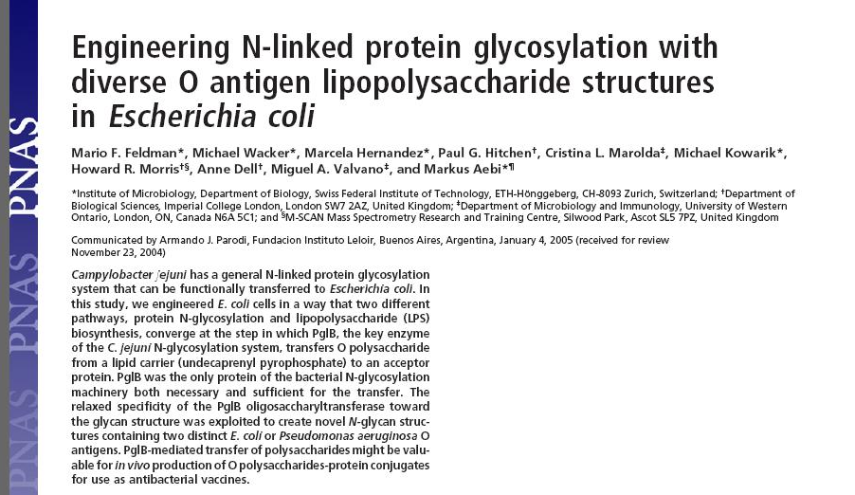
Notes:
In this paper from Feldman, a chimeric biosynthetic pathway between a surface polysaccharide and a glycoprotein lead to an interesting example of composability.

Slide 38
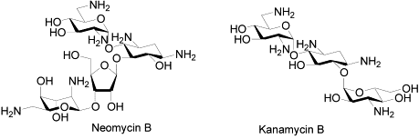
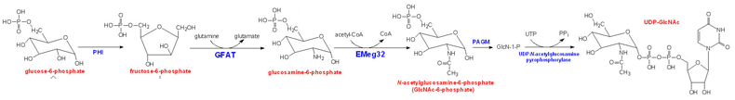
Engineering carbohydrates
Therapeutic applications include antibiotics and glyco proteins
For all carbohydrate engineering, there are soluble nucleotide sugar intermediates
Notes:
Carbohydrates are particularly useful as therapeutics. Small-molecule carbohydrates are a common class of secondary metabolites, especially as antibiotics. For example, Optimer Pharmaceuticals is a pharmaceutical company founded on the idea of combinatorial small molecule carbohydrate drug discovery. Additionally, carbohydrates are sometimes necessary for the function of therapeutic proteins, or if introduced synthetically, could improve the serum half-live or immunogenicity of a therapeutic protein
For all carbohydrate engineering, there are soluble nucleotide sugar intermediates. The enterobacteria produce a diverse array of capsular polysaccharides, and as a result, there are enterobacterial pathways for many nucleotide sugars that could be easily moved to an engineered E. coli. Here’s an example of one of these pathways that takes glucose-6-phosphate to UDP-GlcNAc. So, you really only need to add transferases and polymerases to design new carbohydrates, the nucleotide sugars are off-the-shelf molecules.
In this paper, the authors show you can make a chimeric biosynthetic pathway between two quite different polysaccharide biosynthetic processes

Slide 39
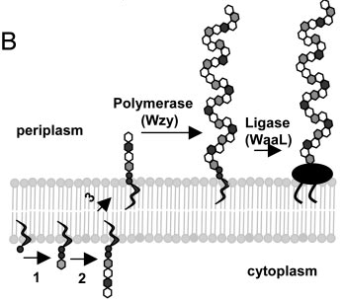
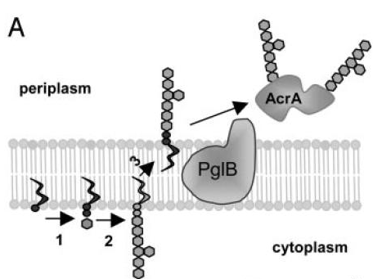
The source pathways
N-glycosylation of proteins by C. jejuni
O-antigen biosynthesis by E. coli
Notes:
In this study, the authors are splicing together two pathways that both involve an oligosaccharide. In the N-glycosylation biosynthesis pathway from C. jejuni, monosaccharides are iteratively added to a growing chain by glycosyltransferases. This oligosaccharide is linked to the inner membrane by a lipid linker and then transferred to the periplasm where it is transferred to AcrA resulting in a glycoprotein. The O-antigen biosynthesis in E. coli similarly starts with a lipid-linked oligosaccharide that is transported across the membrane, but then it is polymerized into a 40-unit polymer and transferred to another lipid anchor. These two pathways involve different oligosaccharides, but beyond this consideration they perform the same sequence of steps to give rise to *click* this periplasmic oligosaccharide intermediate.

Slide 40
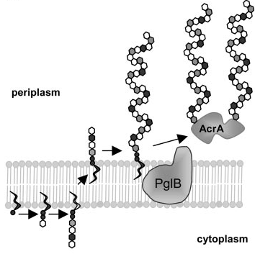
The target pathway
Notes:
What they show in this paper is that they can splice the two pathways together over this intermediate and obtain glycoproteins in which AcrA has picked up the O-antigen’s oligosaccharide. Predicting that this sort of composition should work is challenging. It all boils down to the substrate specificity of the particular enzymes involved in transfering and polymerizing these oligosacccharides. Sure, superficially this chemical intermediate looks really similar between the two systems, it has a bunch of sugars and they are attached to the same lipid linker. However, they employ quite different sugars in different configurations, and it is unclear which of these enzymes will tolerate which substrates. We don’t currently capture models of substrate specificity at all in biochemical databases. This is particularly true of these more exotic enzymes.

